Slide 1
Data Science

Slide 2
Myself
Name: Sharan Sasi
Profession: Data Scientist
Experience: 5 Years
Expertise: Python, Machine Learning, R, SQL

Slide 3
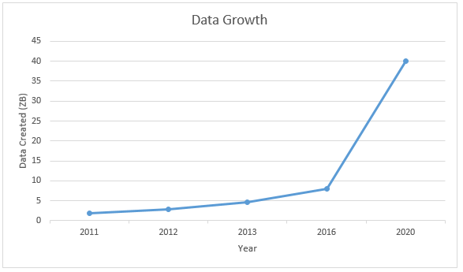
What is Data?
“Data is information”

Slide 4




Data everywhere!
Lots of data is being collected and warehoused
Web data, e-commerce
Financial transactions, bank/credit transactions
Online trading and purchasing
Social Network

Slide 5
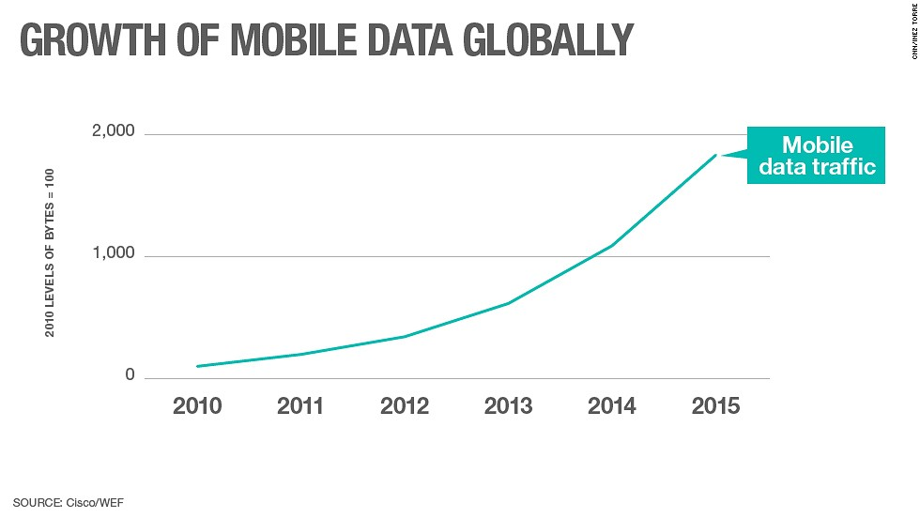

How data growth?

Slide 6
What is Data Science?
Data science is the study of extracting knowledge from data.
Signal processing, statistical learning, machine learning, computer programming etc are the many fields that come under the category of Data science.
Data science is a multi-disciplinary field that uses scientific methods, processes, algorithms and systems to extract knowledge and insights from structured and unstructured data
Wikipedia

Slide 7
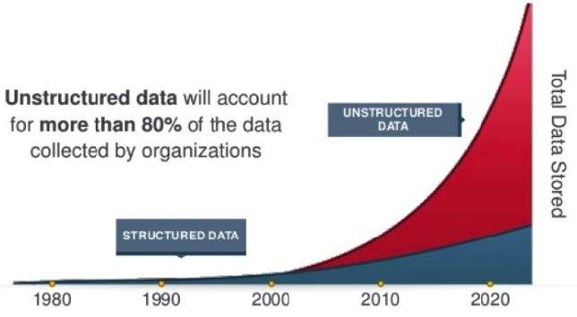
What is structured and unstructured data?

Slide 8
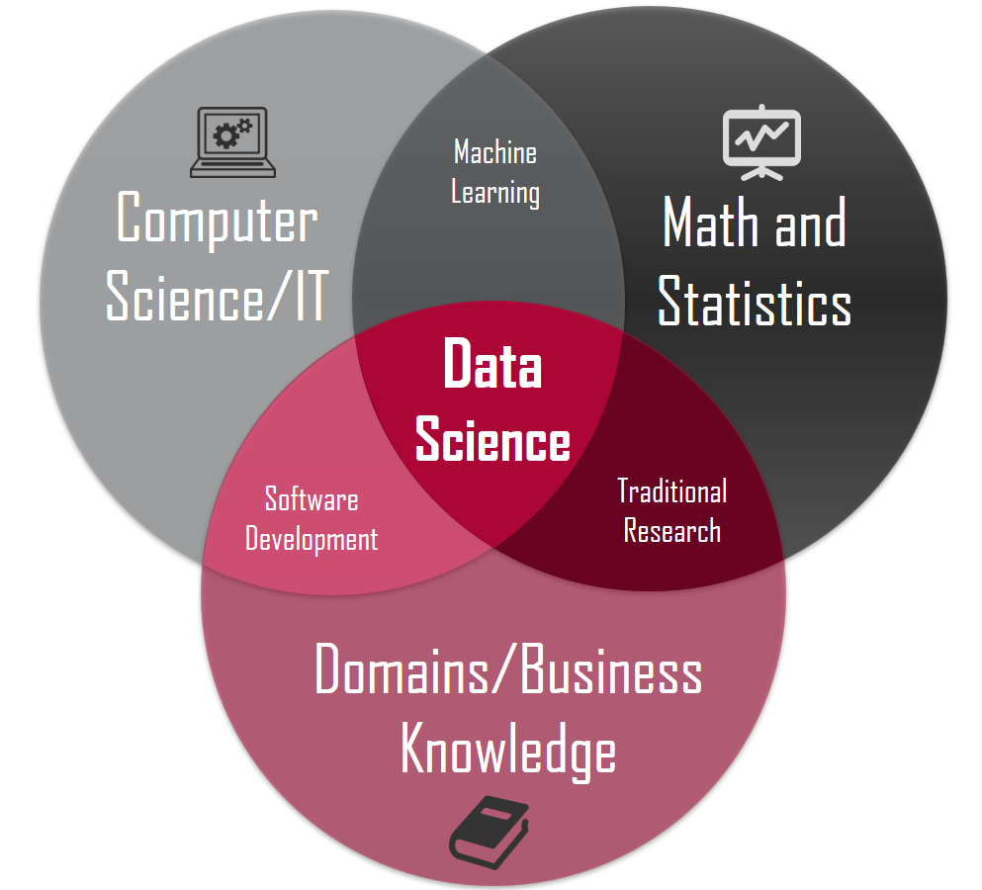
What is Data Science?

Slide 9
What is Data Science?
“Data Scientists: The Definition of Sexy”
-Forbes, 2012
“Data Scientist: The Sexiest Job of the 21st Century”
-Harvard Business Review, 2012

Slide 10
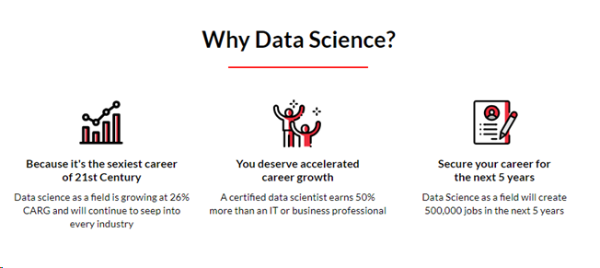
Why Data Science?

Slide 11
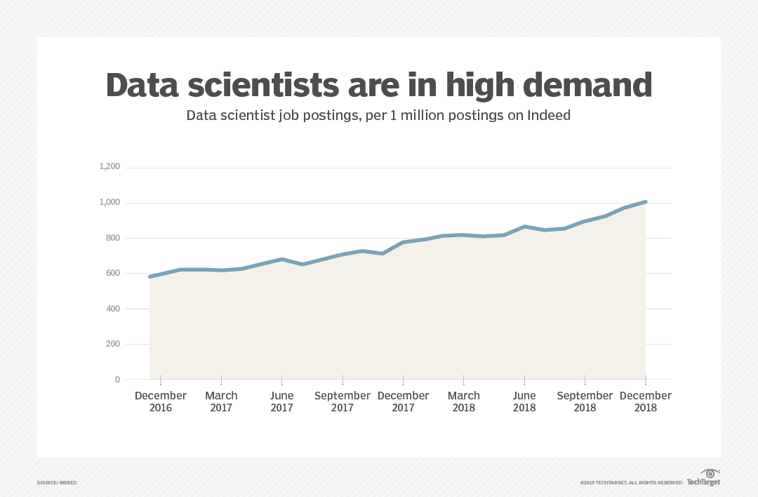
Why Data Science?

Slide 12
Who is Data Scientist?
Mathematics + Statistics
Programming
Business understanding
Calculus
Probability
Statistics
-Proficient in any one programming language
-Python is best choice
-Domain knowledge understanding

Slide 13
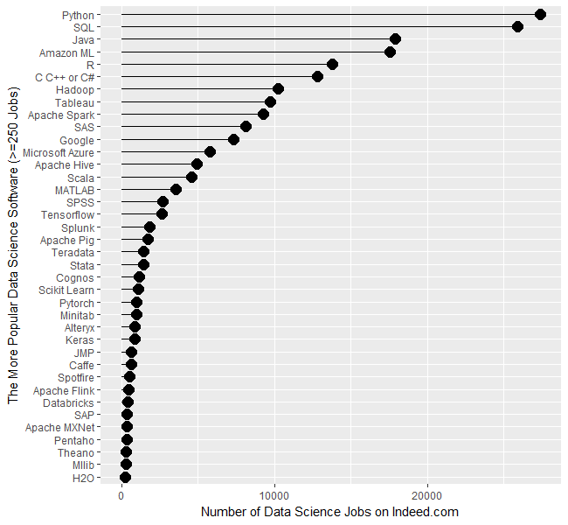
Why Python?

Slide 14
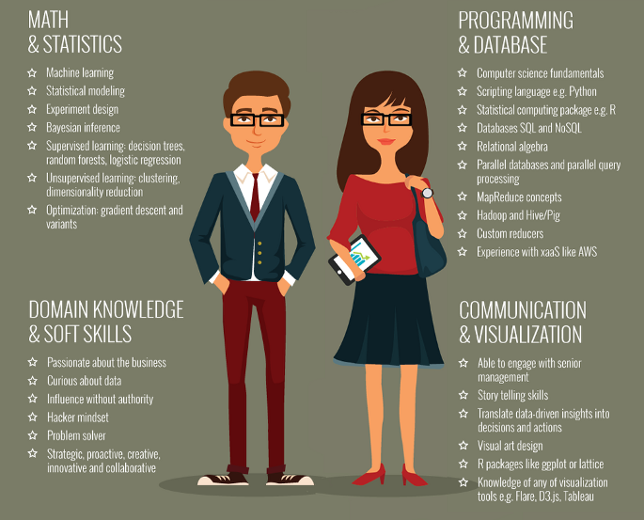
How to become a Data Scientist?

Slide 15
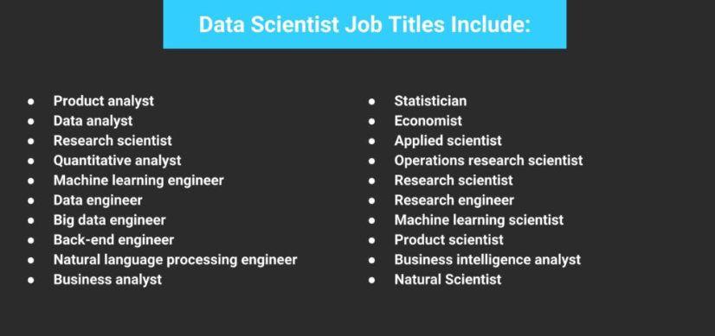
What jobs Data Scientist do?

Slide 16
What you’re going to learn in Crampete..

